Slide 1
Molecular clocks and gene duplication week 38 Paper discussion

Slide 2
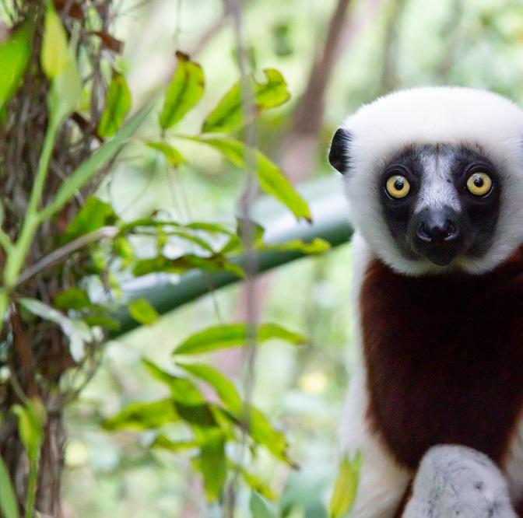
Primate of the Week
COQUEREL'S SIFAKA
Propithecus coquereli
Madagascar
Matriarchy group
Polyandry
→→ Help to avoid infanticide
“shuh-fokk” sound they often make as a warning call

Slide 3
Plan for today
1. Recap of questions from Wednesday
Wednesday questions are not part of the exams directly -> they’re to practice with the concepts
2. R exercises using the ape package

Slide 4
Phylogenetic trees
Maximum parsimony
Think: Simplicity
Look at all possible trees and count how many changes are needed
The tree with the fewist changes is chosen
→ the simplest explanation is the most parsimonious.
Likelihood method
Think: Statistical fit
Pick a model
Test different parameters under that model
Tree that makes the observed DNA sequences most likely is chosen.
Then you can compare the maximum likelihood of the different models to see which model (with which parameters) actually fit best

Slide 5
Phylogenetic trees
Maximum Parsimony (MP) :
The tree with the least number of changes (simplest explanation wins)
good for simple cases, small datasets
Minimum evolution (ME):
looks at the overall branch lengths -> tree with the smallest total length (shortest overall evolution)
a compromise: faster than ML, less simplistic than MP
Maximum likelihood (ML):
choose tree that makes data most probable. ”is this tree were true, how likely is it that I would see these sequences”
generally best for accuracy -> especially with larger datasets and complex evolution
In MEGA you can build trees in different ways. Each method tries to show how species or sequences are related but they use different rules to decide which tree is best
ML is most widely trusted today but often you just compare methods to check consistency.

Slide 6
Molecular clock
The idea: DNA and protein sequences change at rougly steady state over time.
So if 2 species DNA differ by a certain amount → can estimate how long ago they shared a common ancestor
How fast species evolve are dependent on many things (go more into that coming weeks)
Generation times
Population size
Species-specific differences
Changes in function of the protein studies
Changes in intensity of selection
Strick clock: assumes all lineages change at exactly the same rate → every species evolutionary clock ticks at the same speed
Relaxed clock: allows different lineages to tick at slightly different speeds.
Test: you can do a likelihood ratio test to check if the constant rate assumption holds.

Slide 7
Today
Building evolutionary trees in R using the ape package
Work in groups !

Slide 8
Next week – Population genetics & coalescent

